Slide 1

Modes of Radioactive Decay II
RTT4220 – Lecture #4
Kedree Proffitt
WSU
09/02/2025

Slide 2
Review of Last Lecture
Gotta gotta get it

Slide 3
Types of Radiation (by particle type)
Alpha Emission ($α, {}_{2}^{4}{\text{He}}$)
Alpha Emission (𝛼, (_2^4)"He" )
Massive
Charged (+2)
Low penetration
Beta Emission ($β^{−}, β^{+}$)
Beta Emission (𝛽^−, 𝛽^+)
Low weight
Charged ($±1$)
Charged (±1)
Medium penetration (very energy dependent)
Gamma Emission ($γ$)
Gamma Emission (𝛾)
Massless
No charge
High Penetration

Slide 4
Types of Radiation (by mode)
Fission
One heavy nuclide → 2 or more fission products + energy Q
Fusion
Two light nuclei → 1 heavier nuclide + energy Q
Alpha Emission
Emission of helium with energy ~ 8-10 MeV, externally safe, heavy and neutron rich
Beta Emission
Emission of electron or positron, spectrum of energies, light and proton rich/deficit
Excited State Gamma/Isomeric Transition
Internal Conversion
Attempted gamma emission → electron emission, set energy
Emission of photon
Electron Capture
K-shell electron consumed by nucleus and proton, competitive with positron, vacancy

Slide 5
Radioactive Nuclides in Context
Wait, we make it for a reason?

Slide 6

Methods of Increasing Stability
Nuclei tend toward more favorable energy states (least potential energy)
Many possible ways that nuclei obtain the above:
  Nuclear Fission (heavy elements)
  Nuclear Fusion (lighter elements)
  Radioactive Decay

Slide 7
How are Radioactive Elements Made?
Naturally occurring:
  Products of nuclear fission from heavy elements made in supernovae
  More commonly heavy, long half-lived elements like radium, occasionally lighter elements like carbon-14 due to other events like cosmic rays interacting with nitrogen in the atmosphere
  Anything with Z > 82 is radioactive, man-made or natural
Man-made:
  Created by cyclotrons (proton excess)
  Byproduct or created in nuclear reactors (neutron excess)
  Common examples: O-15, F-18, Cs-137, Mo-99

Slide 8
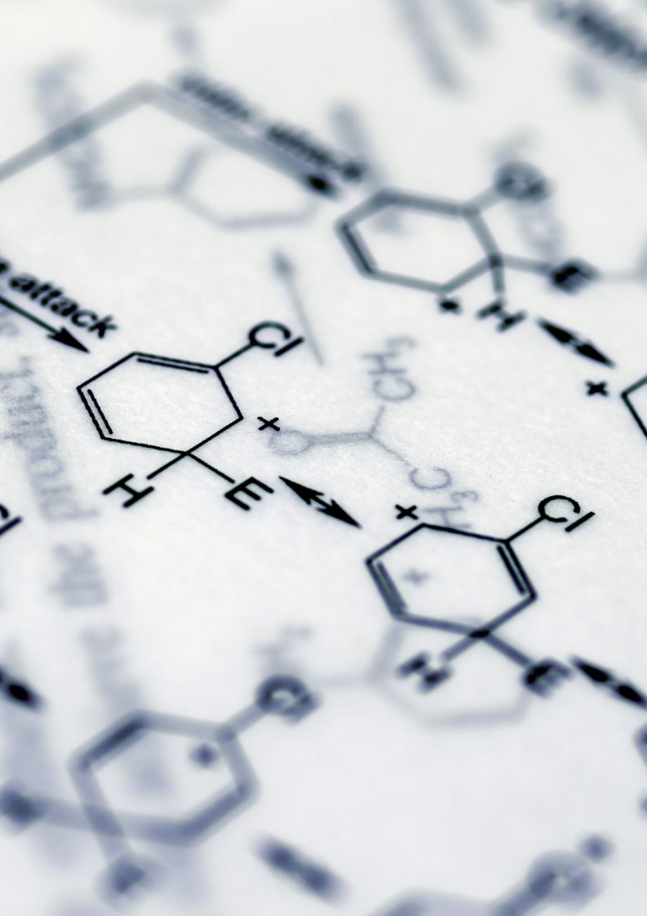
Use of Radioactivity
Smoke detectors (Amercium-241)
  There are electronic ones too! Research it!
Carbon Dating
  Carbon sinks (plants and animals) take in carbon until death,
  C-14 has long half-life, can predict when it stopped taking in carbon (DEATH)
Sterilization (Co-60)
Radioactive Tracers (F-18 and more)
  Medicinal and Industry
Cancer Treatment!
  You should definitely know that already

Slide 9

Decay Scheme Diagrams
Stick with me.

Slide 10
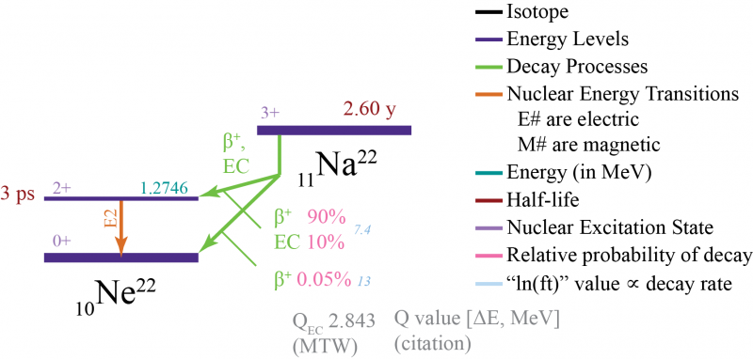


Anatomy of a Decay Scheme Diagram
Energy
Atomic Number

Slide 11
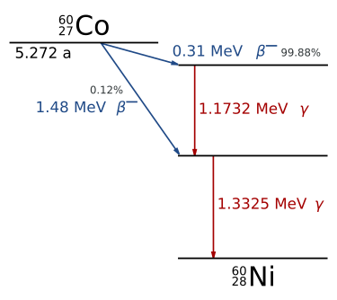
Scheme Diagram Example
What is the Parent and Daughter?
What are the decay modes?
Is Co-60 gaining or losing atomic number?
What is the relative ratio of probabilities?

Slide 12
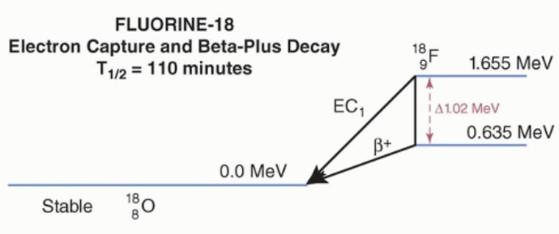
Yet Another Please
What is the energy released during EC?
Why are there two arrows?
Why does one have a vertical line with 1.022 MeV?

Slide 13
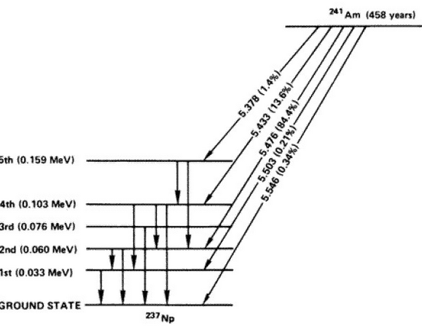
I Swear, Last One
For now…

Slide 14
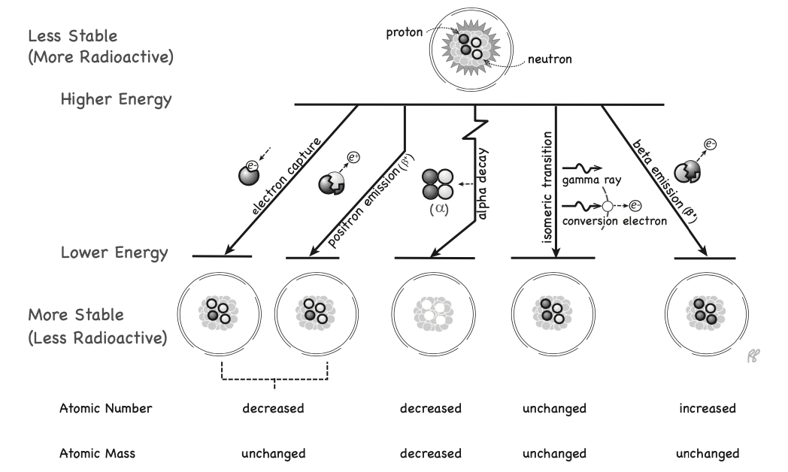
Decay Scheme Diagram Guide

Slide 15

Positron Annihilation
Origin of the 1.022 MeV energy requirement
When positron and electron meet → KABOOM electrons are converted into photons
Matter-Antimatter reaction produces 2 photons
  Conservation of linear momentum → must be two photons
  Rest energy of an electron is 0.511 MeV
  Most often occurs when positron comes to rest → 2x 180 degree opposed photons with 0.511 MeV each
Basis of PET Imaging (Positron Emission Tomography)

Slide 16
